Slide 1

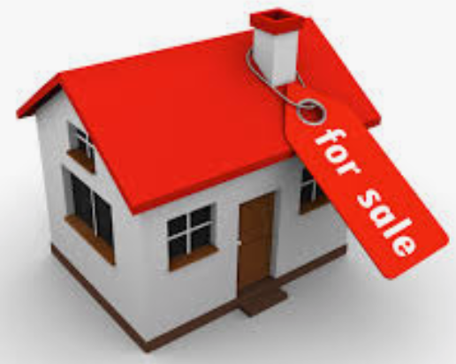
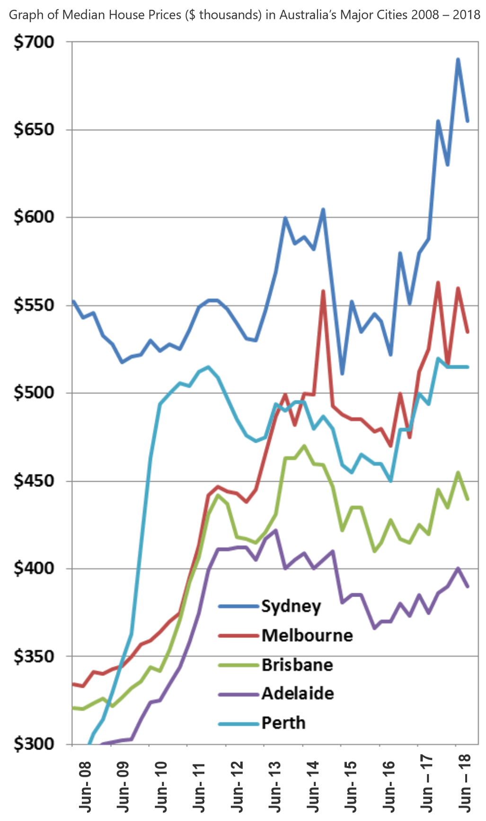

My DSI Capstone Project
Sergio Insuasti
Part I
Project 1 – USA Real Estate Sale Predictions
Estimations on the value of peoples properties
Project 2 – Client Sellable Project
Correlation of Home Sale Prices
Image correlation and improvements
Project 3 – ANZ Wealth
Merge Data, clean and Report statistics

Slide 2
1st Concept Overview
Scope
To develop an automated model that would predict, estimates of home prices.
By allowing the user to alter characteristics(Predictors), and see what affect it will have on the predicted estimate.
Build a front end Data Entry screen
Enter the house address and check if the house is FOUND in our files, if it does exist populate the screen with stored values otherwise notify that it’s NOT FOUND and load the simplest basic house in the street so the User can work from
Allow changes to be made to those predictors by using drop down lists
Capture all entered or selected criteria from Data Entry screen
Build a back end program
Using the captured information calculate a guesstimated price
Do a predicted forecast using the guesstimate
Show Trends against other properties
By using Tableau show forecast for each
country → state → city → street

Slide 3
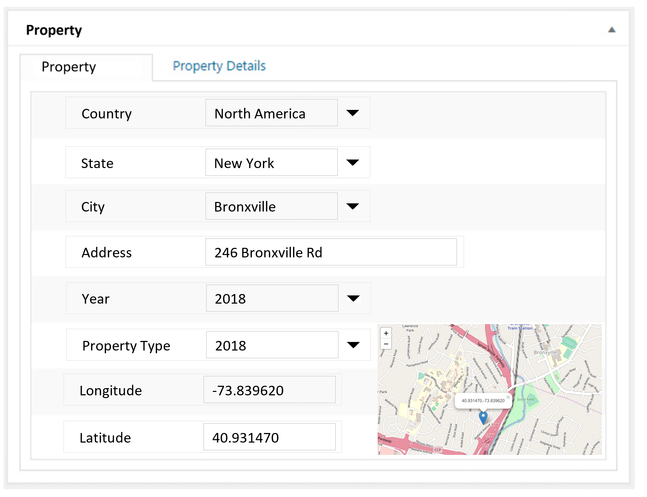
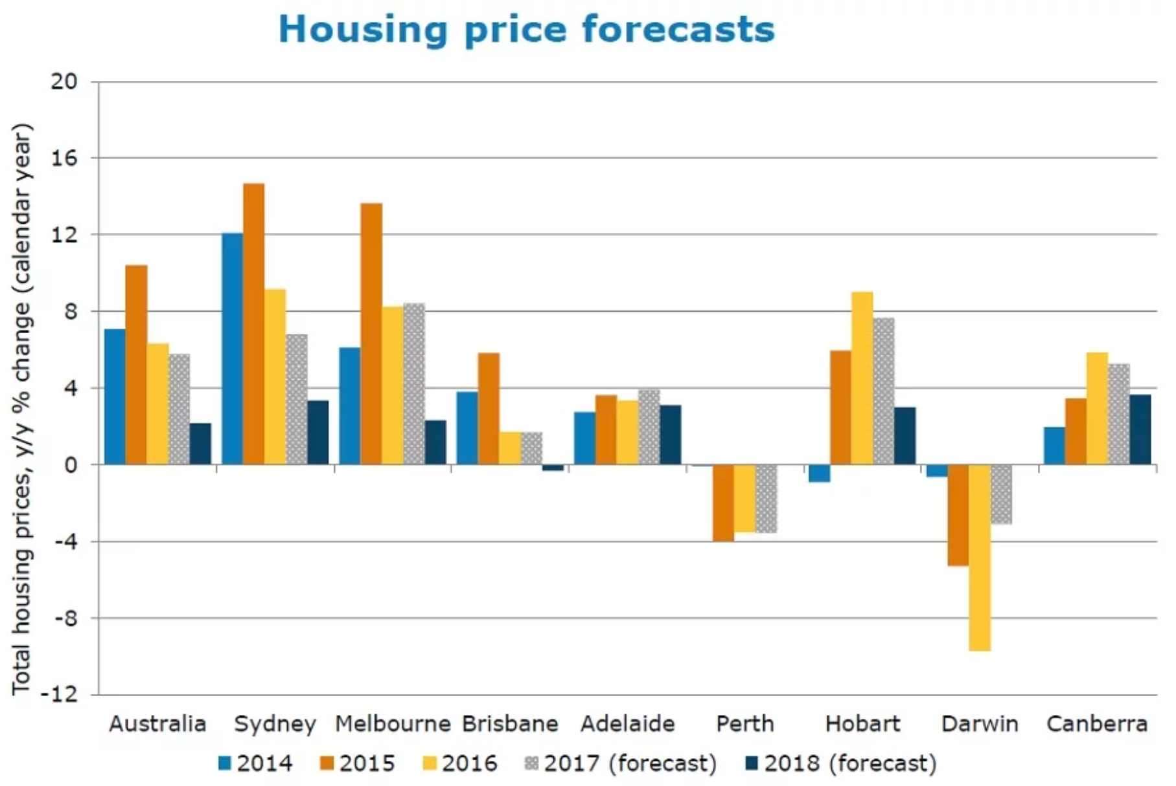
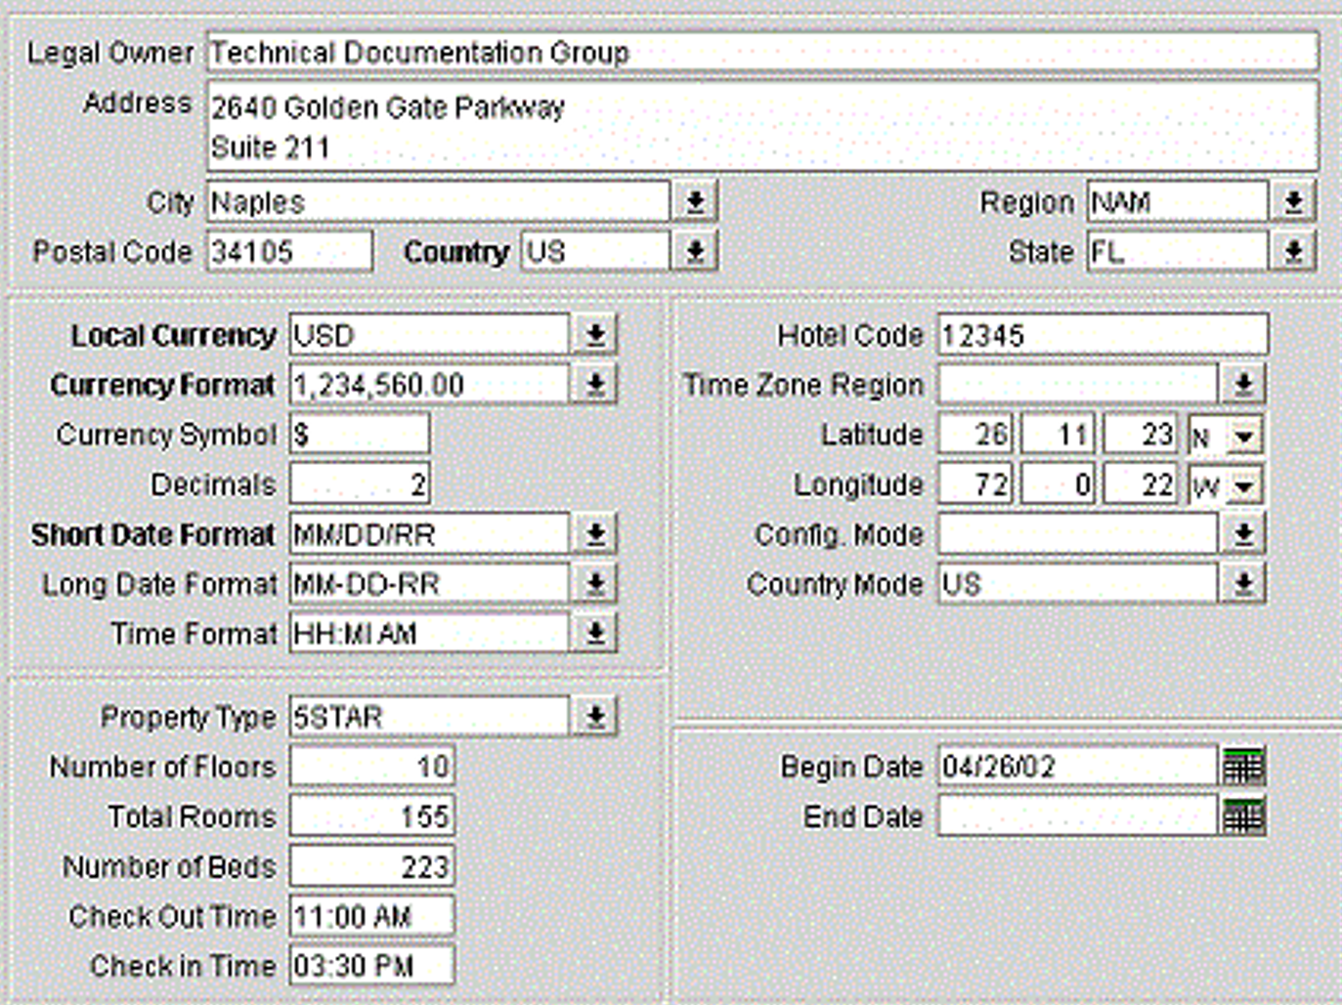
Data Entry Screen
Property Details

Slide 4
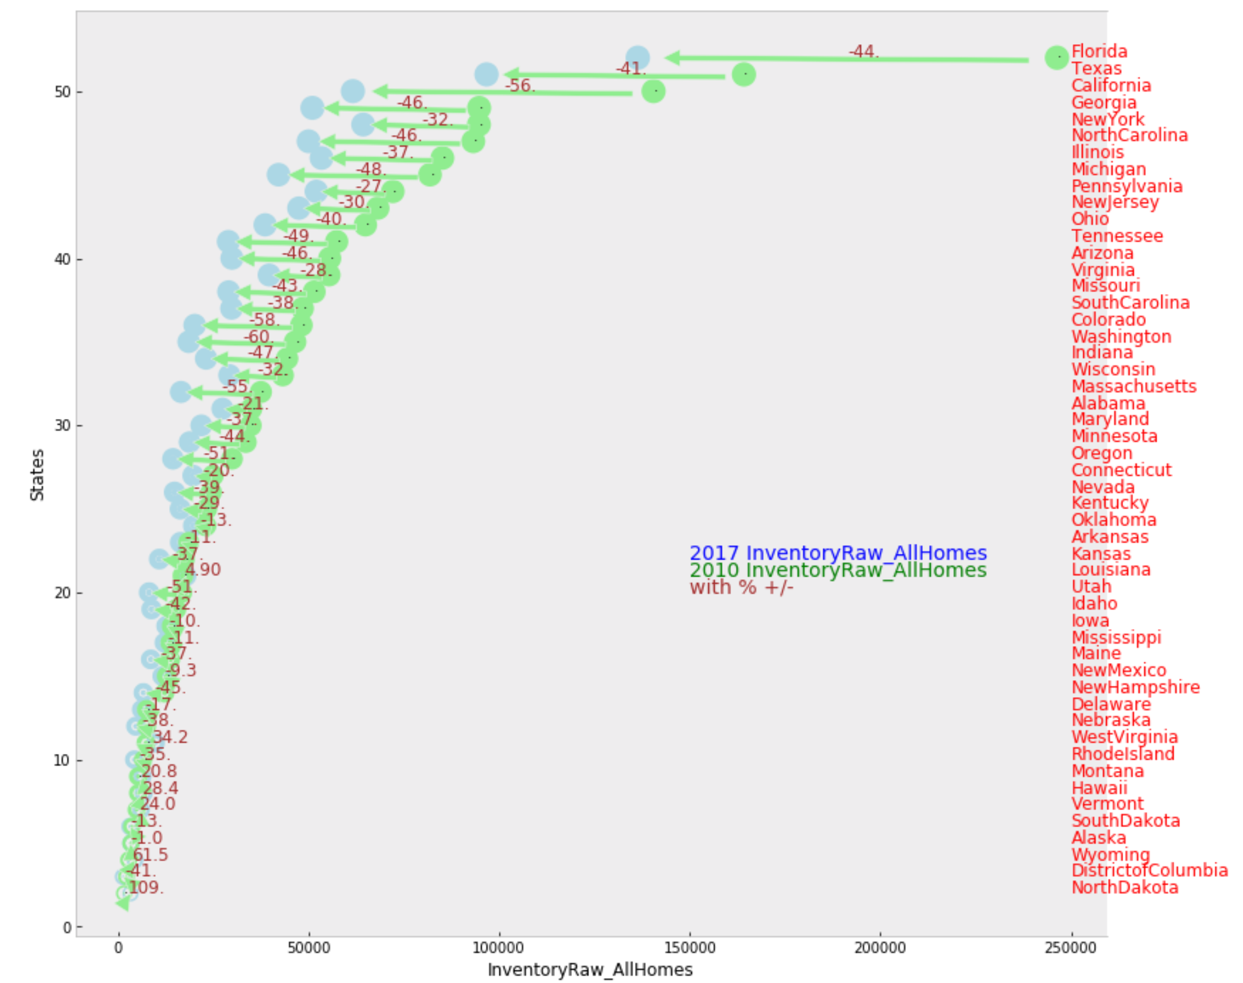
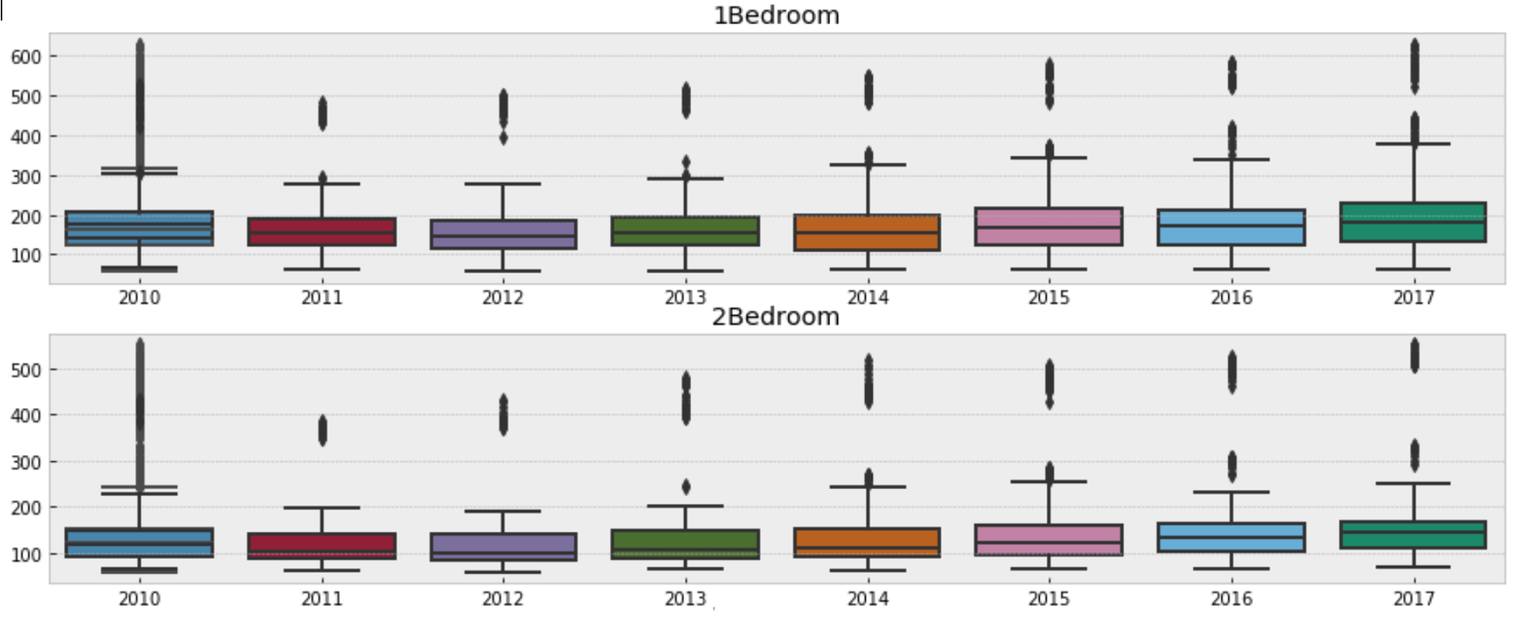
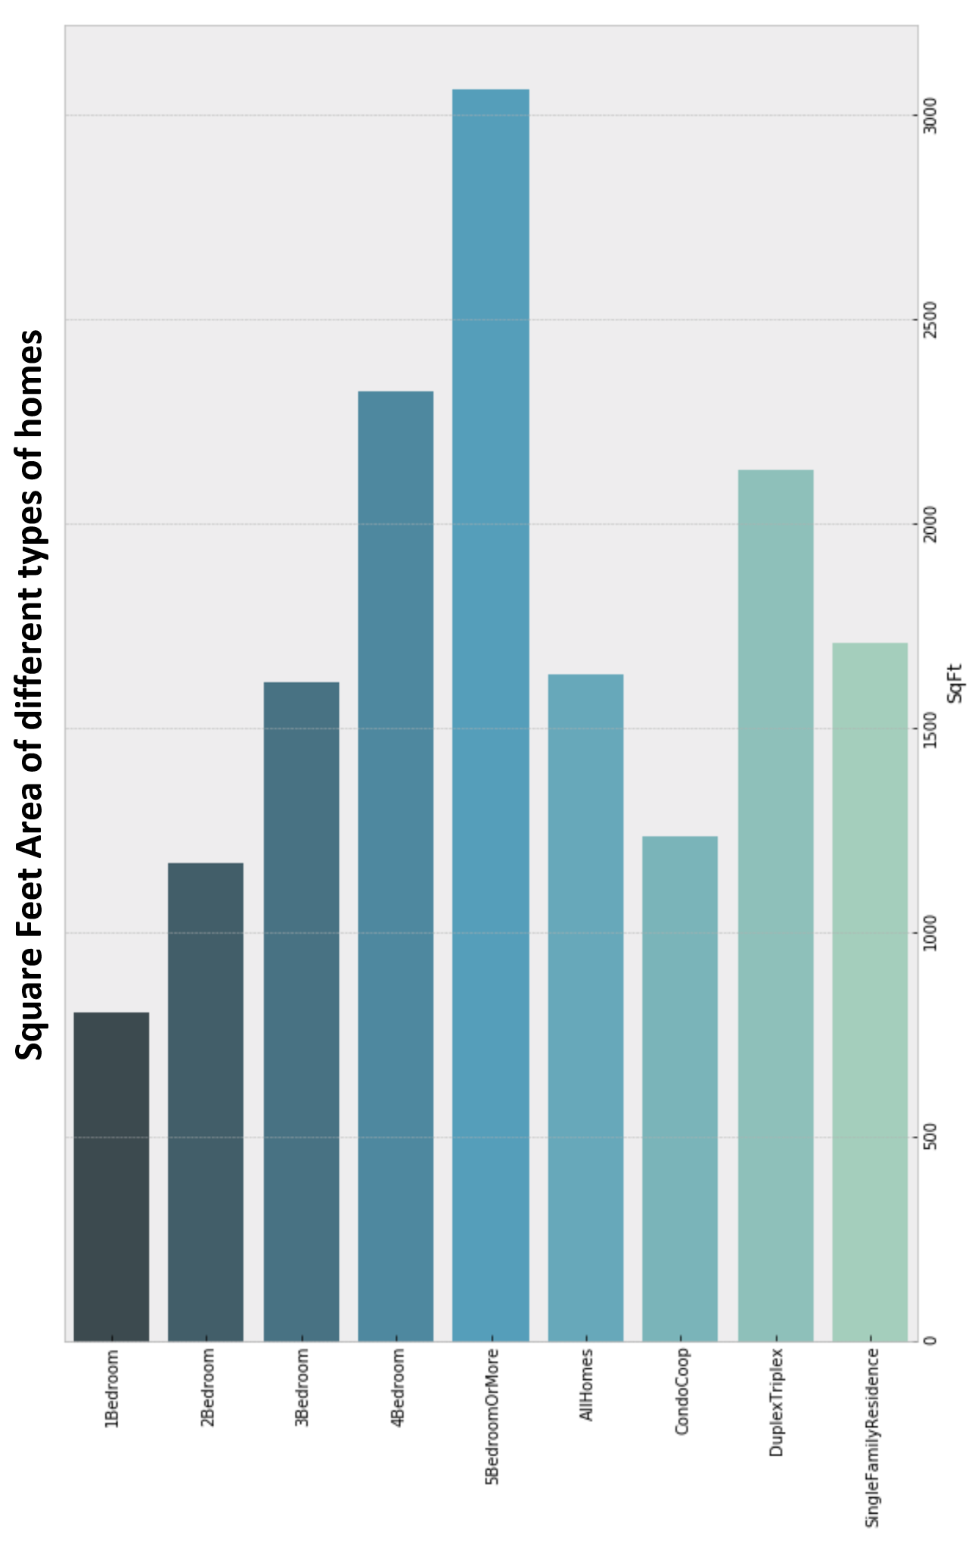
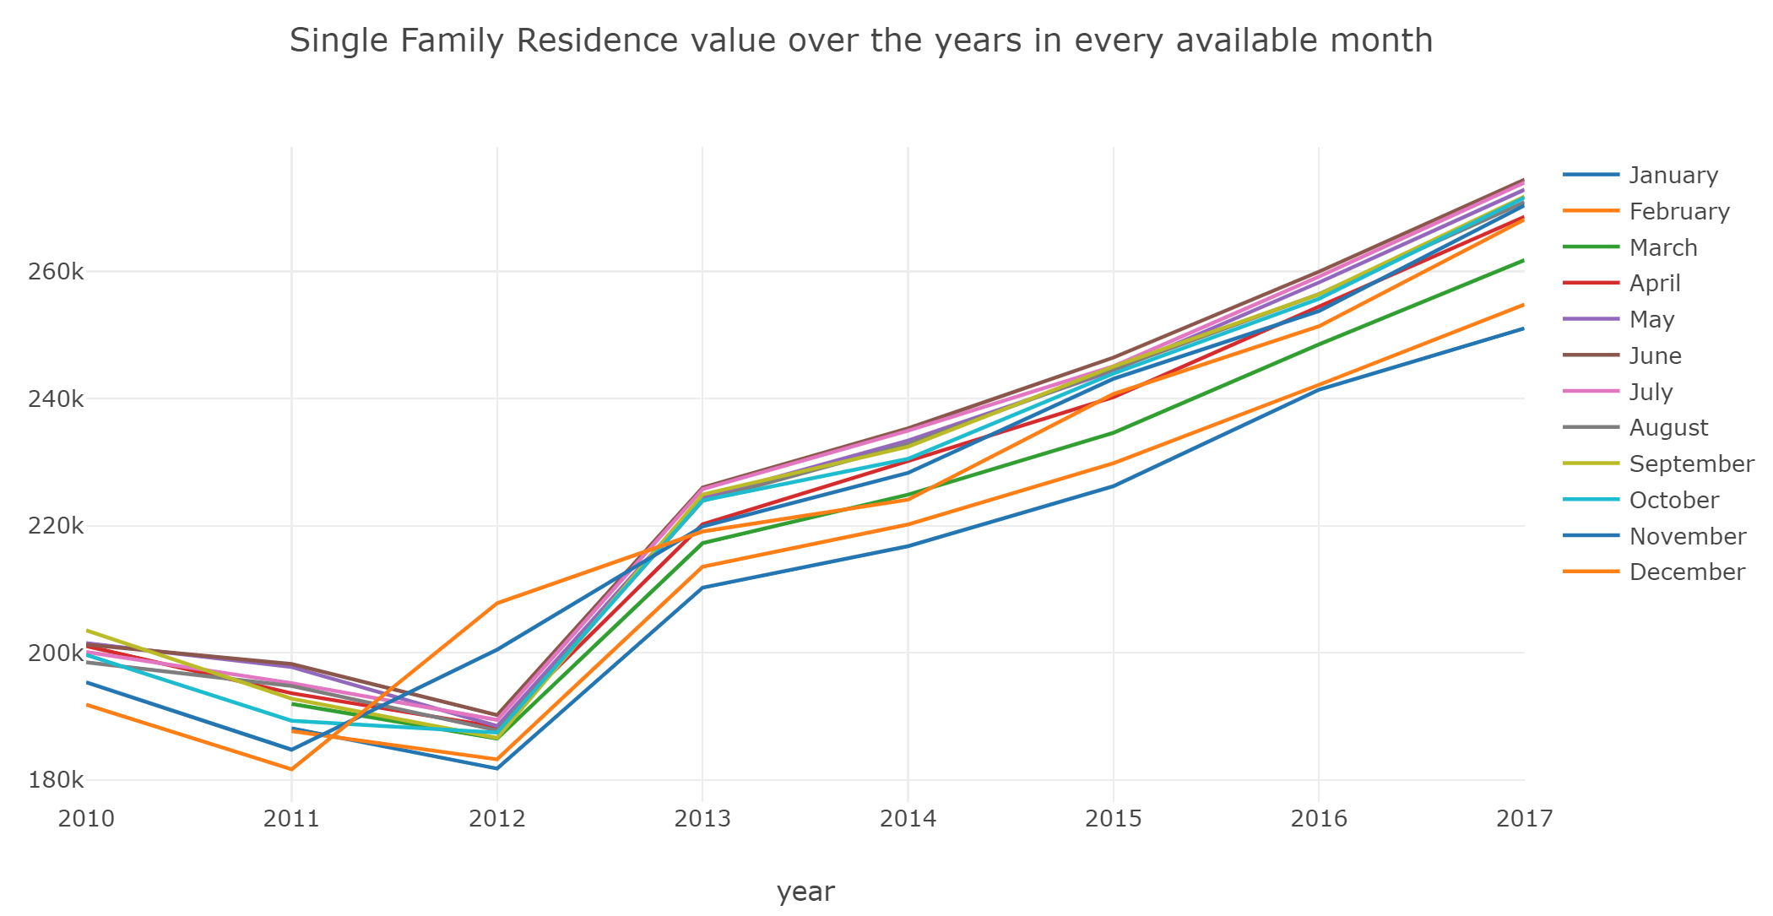
2nd Concept Overview
Scope
By using the data, create statistical graphs showing the correlation between the price vs predictors. The predictors selected would be important enough to make an impact in calculating to the predicted price.
Demonstrate using graphs the predictable algorithm model that would automate an estimated home price.

Slide 5
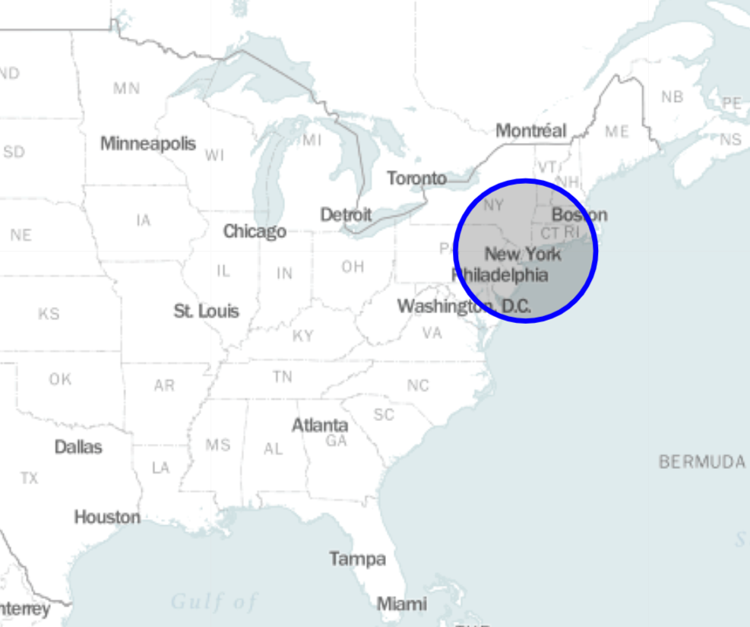
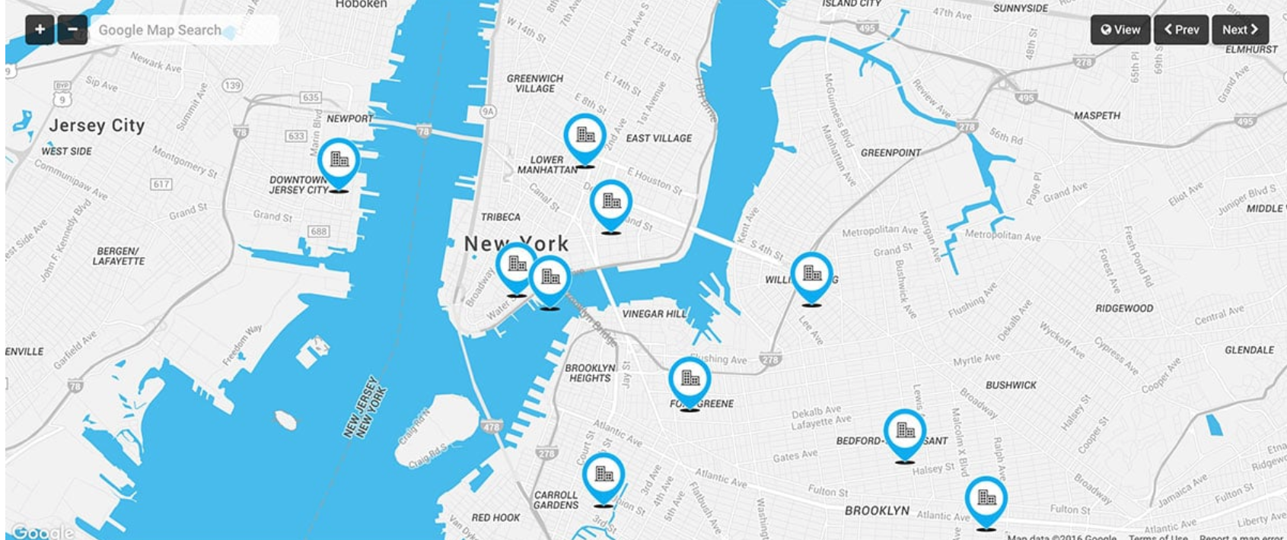
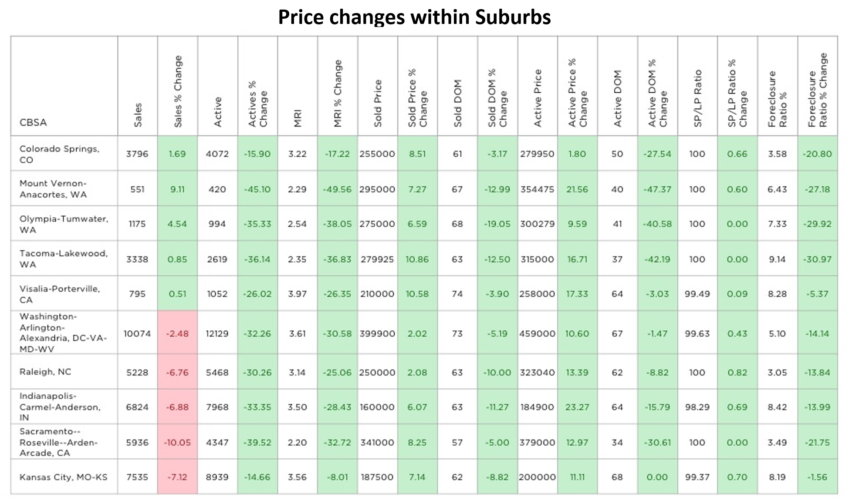
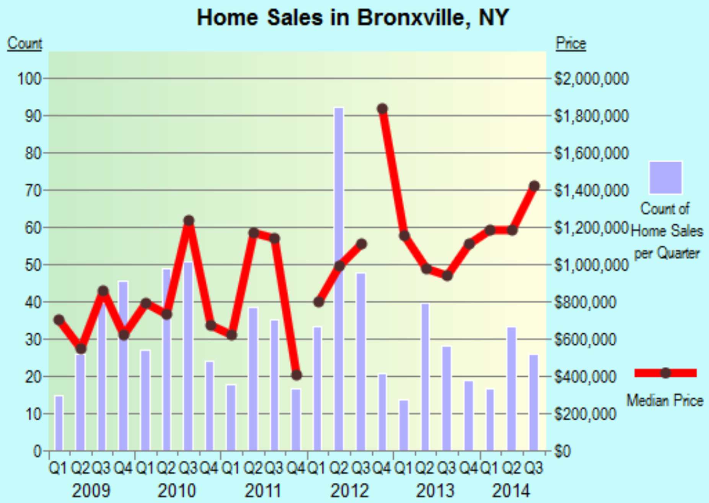
Mapping
Property location
Bar Plots
Histograms
Statistics

Slide 6
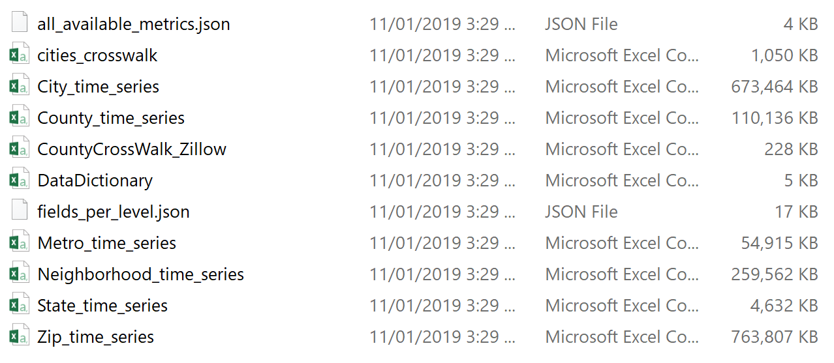
Important Details
Data:
Cleaning:
minimal
Deliverables:
Coleration plots and statistical graph representations of predictors

Slide 7
Client Sellable Project
Part 1: Correlation of Home Sale Prices – NOT SPECIFIED YET
Part 2: Image recognition to make better valuation predictions
Client Name: Sellable Bus. Domain: Real Estate
Company Overview:
Sellable takes the hassle out of selling your home, they are property experts that buy homes, make them look spectacular, and sell it using the best agents in the business.
Currently they are receiving requests for over 200 properties a month.
Scope:
An automated valuation model requires machine learning to make, accurate property valuations. It currently takes many quantitative factors into account, but it is limited to machine readable format supplied by their providers which impacts significantly on their valuations.
Data requires further cleaning, satellite imagery needs to be obtained from external parties like google maps, predictors like busy streets/intersections, high voltage power lines, mobile phone/radio towers, or pools need to be include into valuation process.

Slide 8
Important Details
Data:
212k Addresses (street, suburb, postcode, state, lat/long)
Land size for each address
may not be always correct, so outliers would need be removed
Property type for each address
Satellite imagery
Google Maps if required
Data is in PostgreSQL
Addresses: 40MB
Map tiles: 2,960 GB
Cleaning:
Land sizes may not be always correct, so outliers would need be
identified and removed/fixed.
Deliverables:
Clean Address information merged or linked to satellite Images
Colleration plots and statistical graph representations of predictors
Show improvements to the Automated module after implementing machine learning

Slide 9
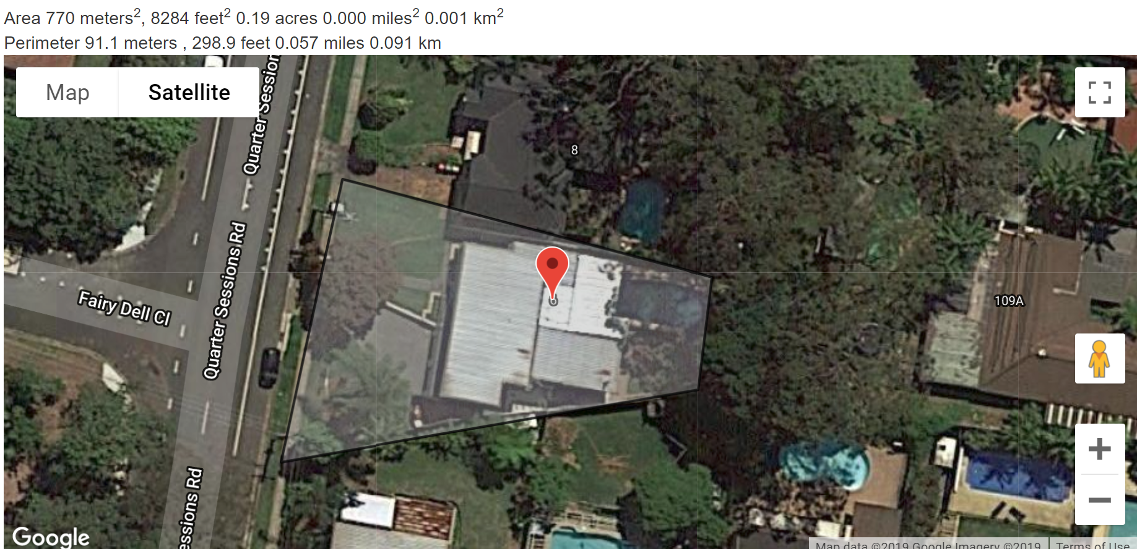
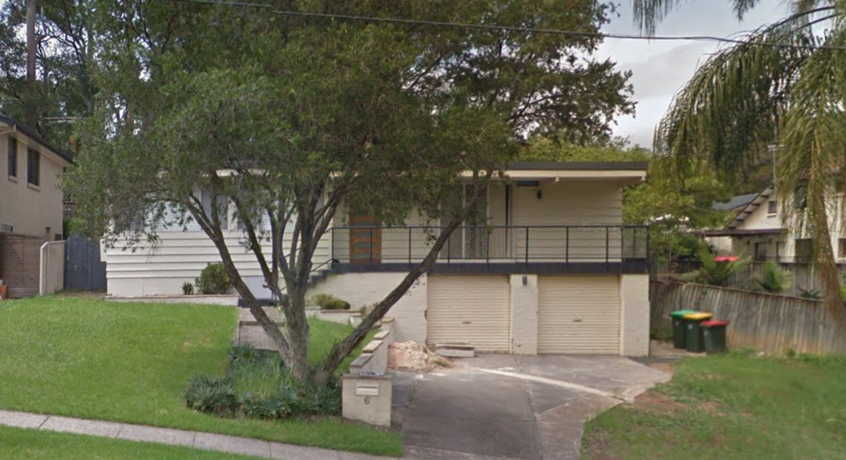
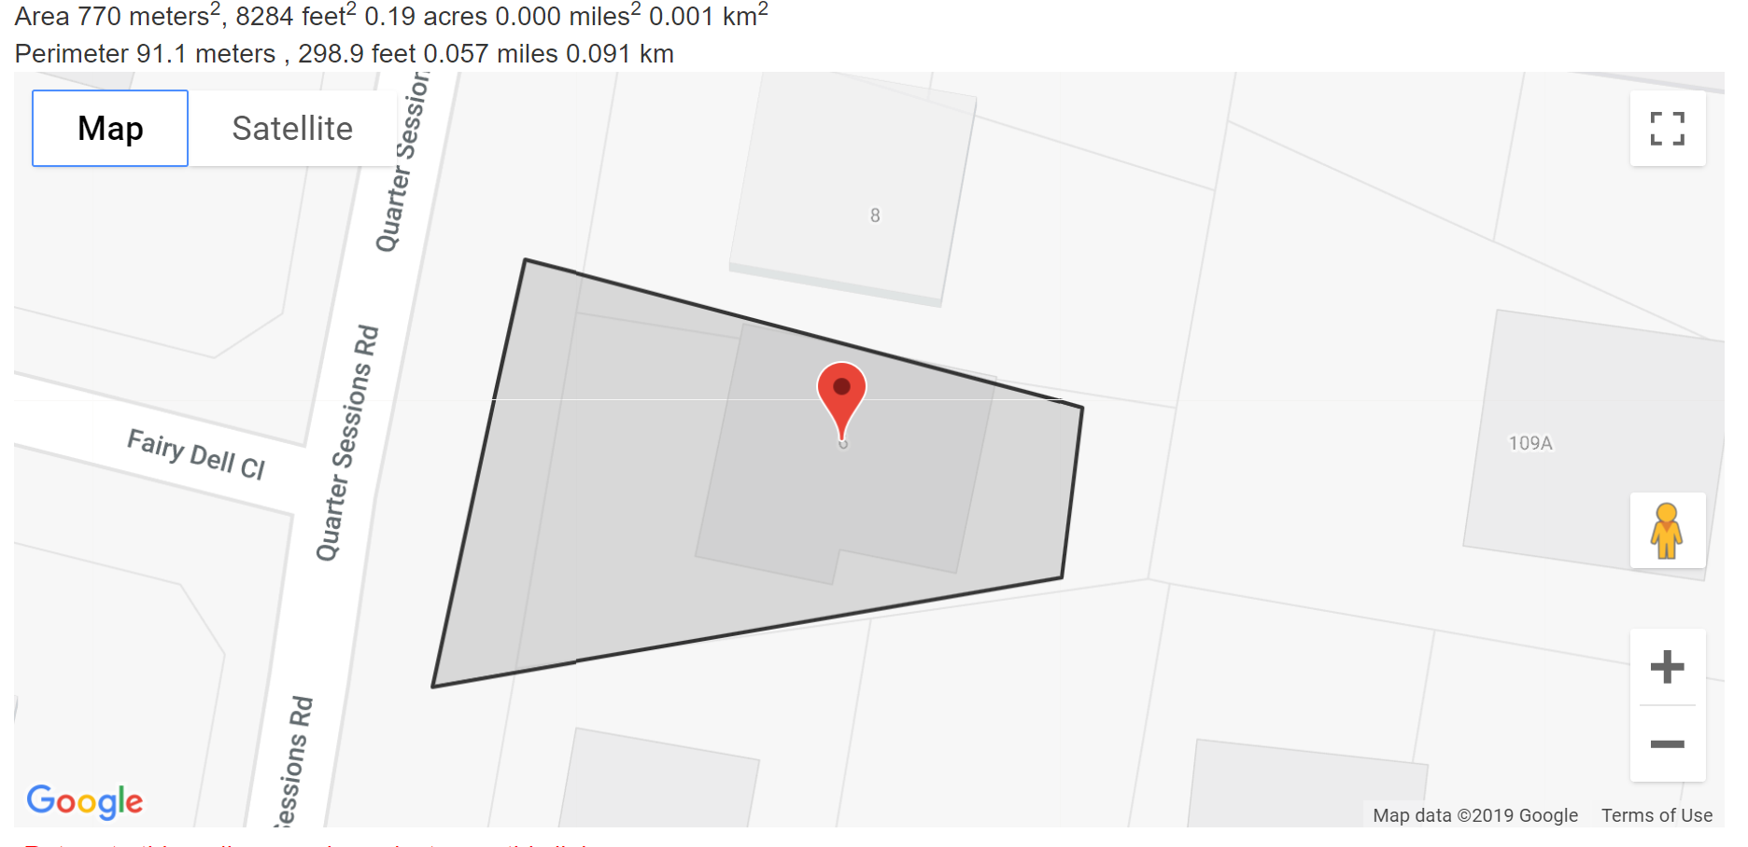

Slide 10
My DSI Capstone
Sergio Insuasti
Project
Part II
Company Overview:
Sellable takes the hassle out of selling your home, they are property experts that buy homes, make them look spectacular, and sell it using the best agents in the business. Currently they are receiving requests for over 200 properties a month.
Data Details
Files were dropped into a Google Drive
Files contain Street, Suburb, Postcode, State, Latitude, Longitude
Clients Data is in PostgreSQL
File
NSW Data (Clean) 7.57 MB (7,940,482 bytes)
Type CSV
Total Records 88,528
Sample Data (Clean) 47.7 KB (48,905 bytes)
Type CSV
Total Records 546

Slide 11
Scope
Data:
Land size for each address may not be
Get correct Land size from
Satellite imagery
Google Maps if required
Clean Address information and
Link satellite Image Lot calculation
Clean Address information and
Link satellite Image Lot calculation
Create correlated plots and statistical graph representations of predictors
Show improvements to the Automated module after implementing machine learning

Slide 12
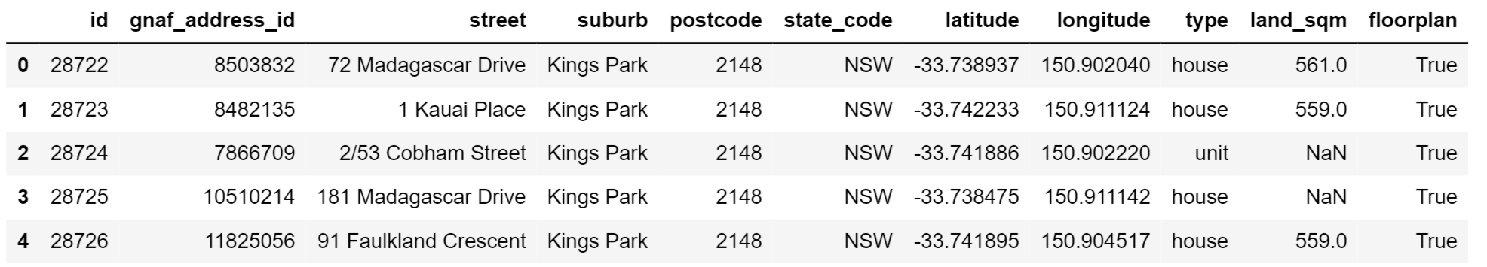
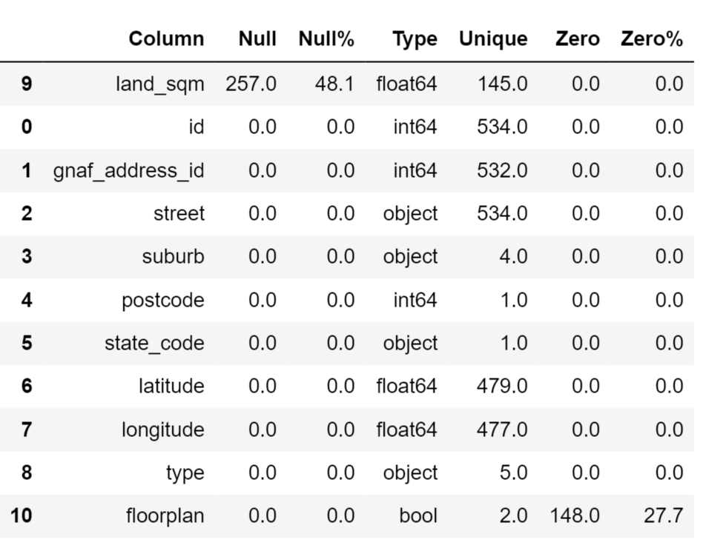
Investigate Client’s Data
Head()
Nulls & Zeros

Slide 13
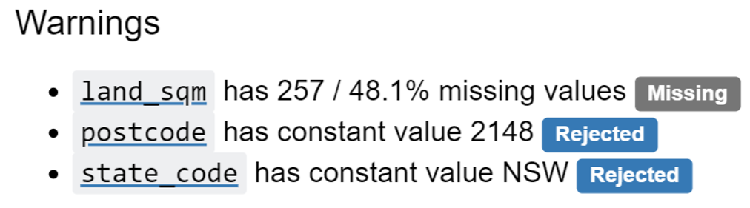
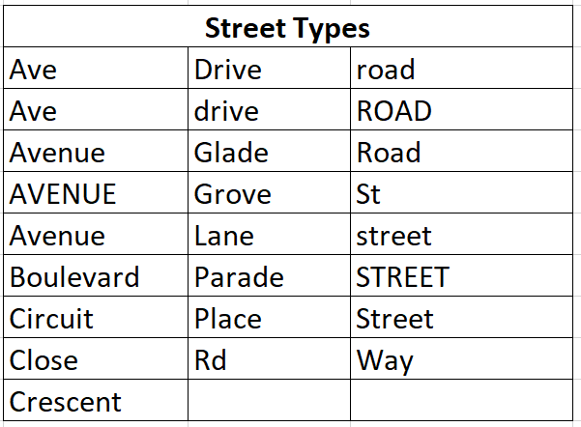
Investigate Client’s Data cont
Shape & Warnings
Shape (534, 11)
Lland_sqm 48% missing
Floorplan 27% missing
Street Cleaning Required

Slide 14
My File Details
Path C:\Users\sergi\Downloads\Sellable Scrapping\Datasets
Street_Abbreviations_on_file.csv
80 records
File contains
Abbreviation
List of combinations
Full Street Type
Modified_Sample_Data.csv
100 records
File contains
Id
Modified Address to access URL
Scrapped_data.csv
Expandable – Not known changes
File contains

Slide 15
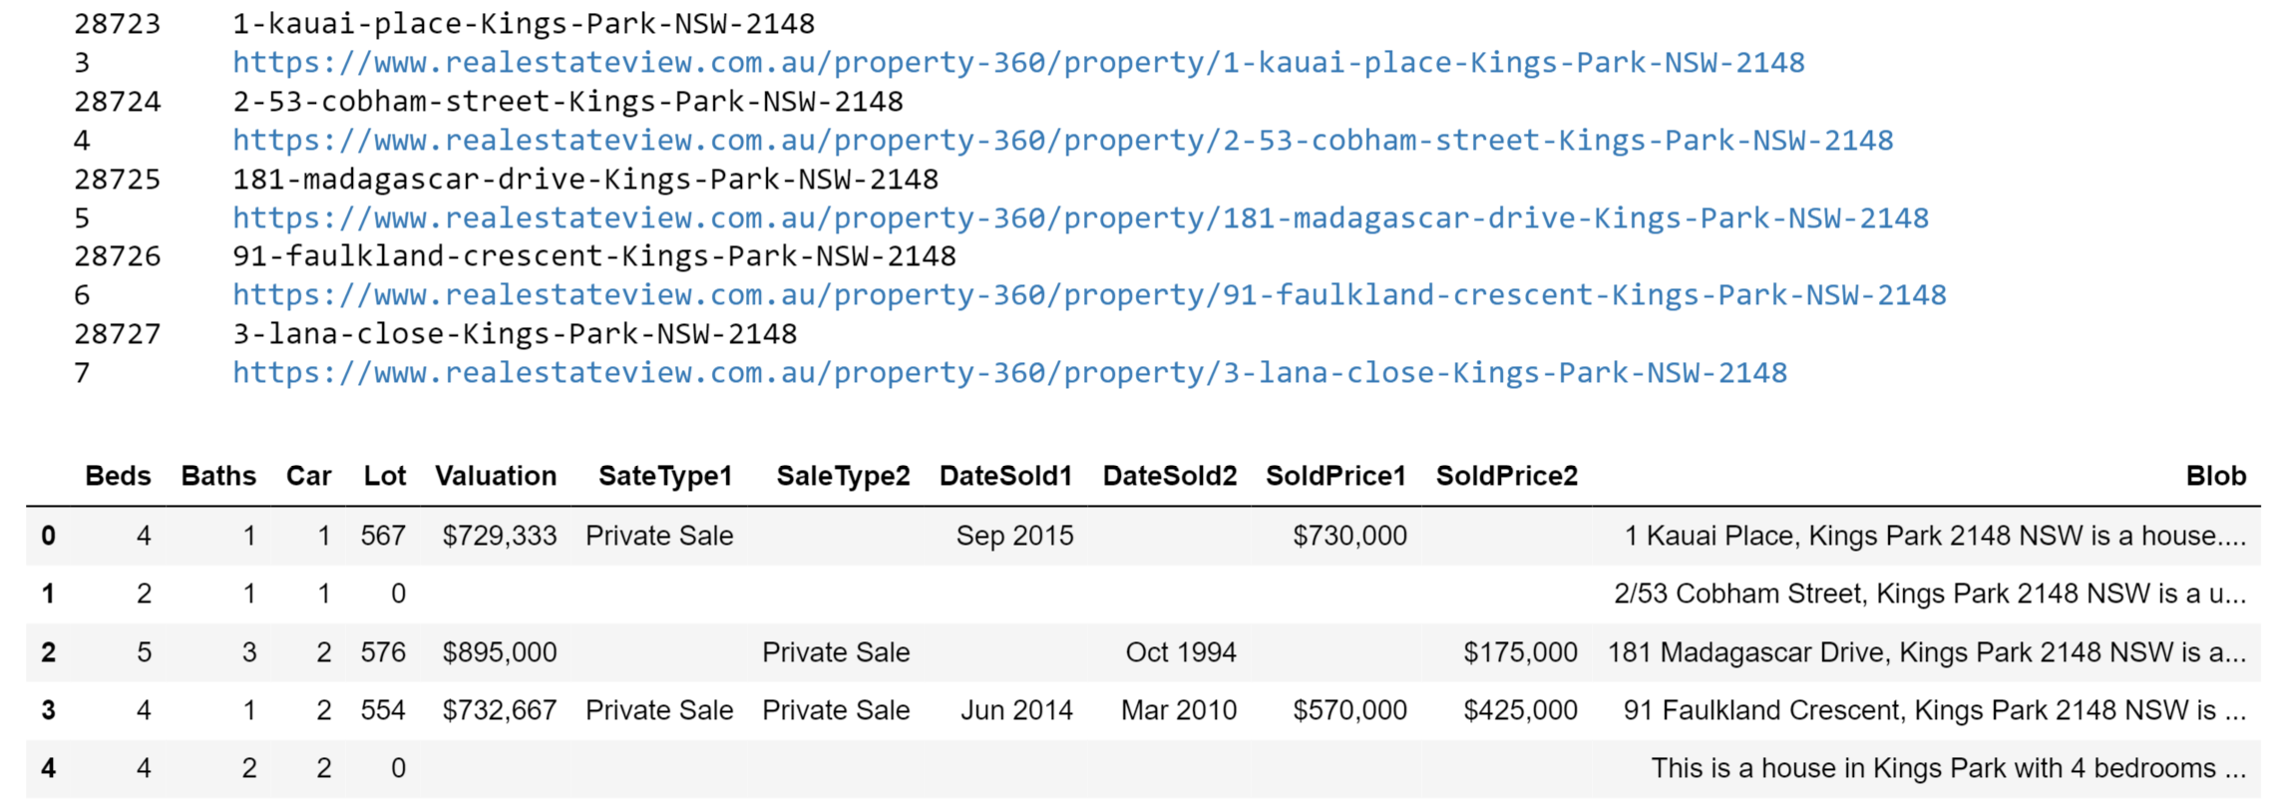
Nulls & Zeros

Slide 16
Yet To Do
Create statistical correlation graphs showing the price vs predictors.
Demonstrate using graphs the predictable algorithm model that would automate an estimated home price.

Slide 17
Mapping
Property location
Bar Plots
Histograms
Statistics

